Slide 1
K-NAV
(KOLKATA NAVIGATION)
Project Guide:
Prof. Kaushik Goswami
By:
JOSHUA BAHIRVANI (Roll no.: 3-15-12-0515)
NABANITA MONDAL (Roll no.:3-15-12-0530)
KASTURI PAUL (Roll no.:3-15-12-0536)

Slide 2
INTRODUCTION
NAVIGATION:
Navigation, in a broader sense, can refer to any skill or study that involves the determination of position and direction.
K-NAV :
An on-the-go consulting tool that will help you to reach your desired location, while giving suggestions on the fare, bus numbers and on the side promote tourism in the City of Joy.

Slide 3
OBJECTIVE OF THE WEBSITE
The website is a tool which a user can apply to provide advice and suggestions to travel more efficiently using the public transport .
Displaying information about the bus or taxi fare, bus numbers going to the required destination , mapping solutions to see your route of travel and in the promote tourism for the city.
Our objective is to take a step to make navigation in the city more efficient by providing :
cost beneficial travelling routes
user-friendliness
Visual representation of routes via mapping

Slide 4
Control Flow Diagram
KOLKATA NAVIGATION SYSTEM
USER
PROGRAMMER
Operates
Feedback
Results,
Feedback
Sets rules,
Constraints / Controls

Slide 5
LANGUAGES AND TECHNOLOGIES USED
PHP: PHP web development means developing websites and dynamic web pages using the versatile and capable server-side scripting language.
XHTML and HTML 5: HyperText Markup Language, commonly referred to as HTML, is the standard markup language used to create web pages.
CSS: Cascading Style Sheets (CSS) is a style sheet language used for describing the look and formatting of a document written in a markup language.

Slide 6
LANGUAGES AND TECHNOLOGIES USED
JAVASCRIPT: It is a dynamic programming language and is most commonly used as part of web browsers, whose implementations allow client-side scripts to interact with the user, control the browser, communicate asynchronously, and alter the document content that is displayed.
Xampp : Is a free and open source cross-platform web server solution stack package, consisting mainly of the Apache HTTP Server, MySQL database, and interpreters for scripts written in the PHP.

Slide 7
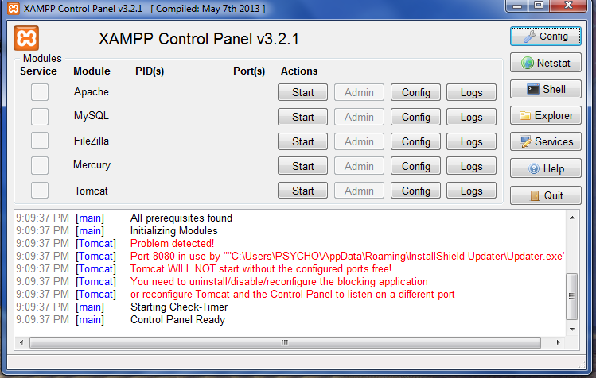
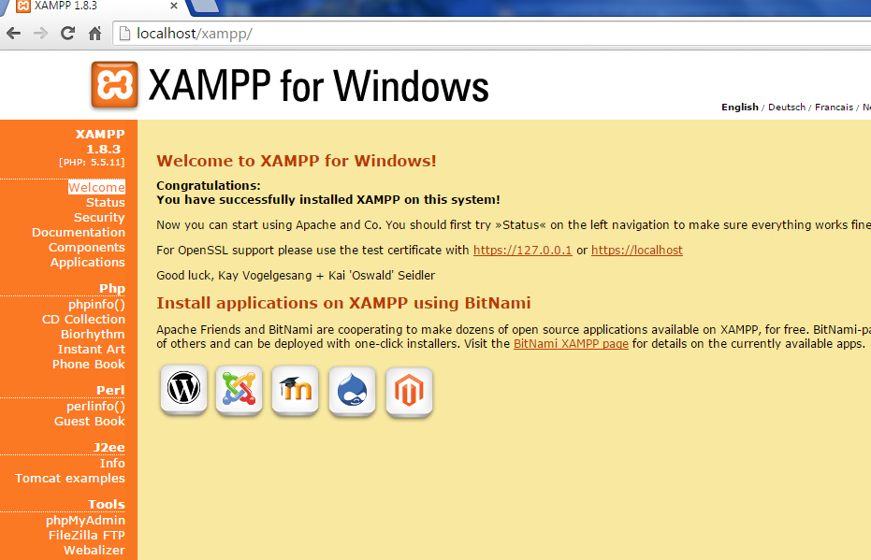
Xampp
Xampp Control Panel
Xampp localhost page running on browser

Slide 8
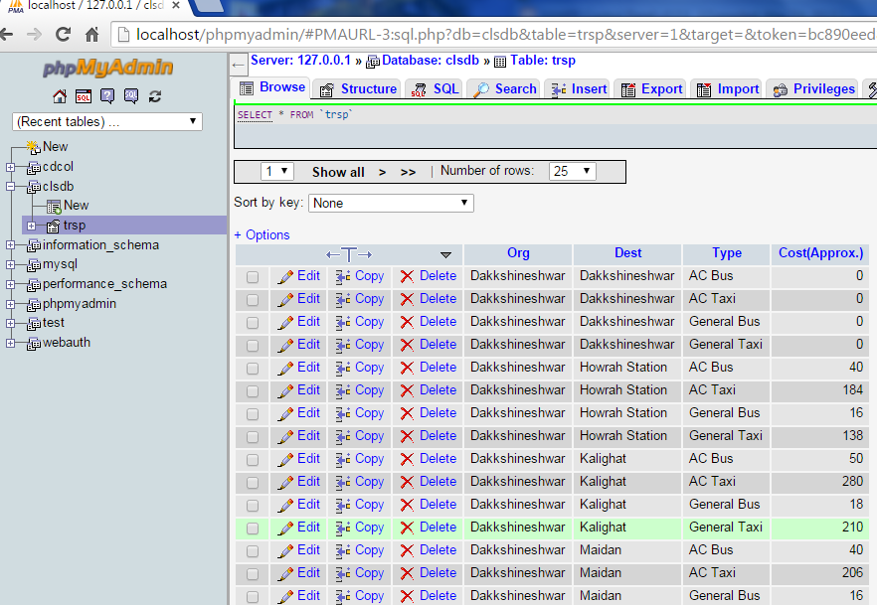
Xampp
phpMyAdmin page for handling the database

Slide 9
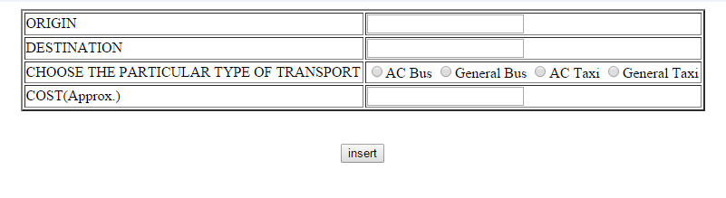
Xampp
Server Side Insertion page for updating the Database

Slide 10
ER DIAGRAM
Org
Dest
USER
USES
SYSTEM
Type
Cost

Slide 11
DATABASE
The database “clsdb” used has table name “trsp” , having attributes Org ,Dest ,Type and Cost(Approx.) i.e. ,
trsp(Org , Dest , Type , Cost(Approx.))
Where Org , Dest and Type are primary key and 1NF Normalization is done.

Slide 12
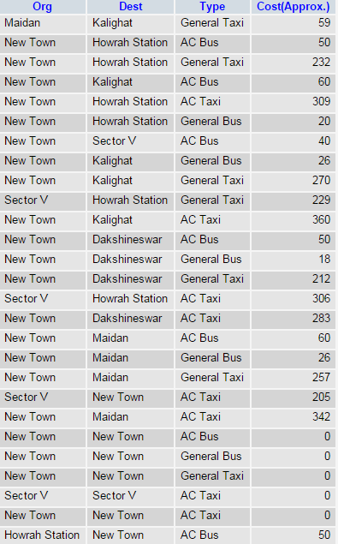
Database
Sample Estimation fare based on distance
Origin | Destination | Distance (in K.M.)
Howrah Station | Kalighat | 12.6
Howrah Station | New Town | 19.3
Howrah Station | Dakshineswar | 11.5
Howrah Station | Maidan | 4.5
New Town | Kalighat | 22.5
New Town | Dakhineswar | 17.7
New Town | Maidan | 21.4
Kalighat | Dakshineswar | 17.5
Kalighat | Maidan | 4.9
Dakshineswar | Maidan | 12.9

Slide 13
Database
TAXI FARE CHART
Distance | AC Taxi (in Rs.) | General Taxi (in Rs.)
1 K.M. | 16 | 12
BUS FARE CHART
Distance | AC Bus (in Rs.)
4 K.M. | 20
4-10 K.M. | 30
10-14 K.M. | 40
14-20 K.M. | 50
>20 K.M. | 60
Distance | General Bus (in Rs.)
4 K.M. | 6
4-6 K.M. | 7
6-8 K.M. | 8-9
8-10 K.M. and above | 10

Slide 14
LOOK AND FEEL
The look and feel of the interface provided is to be easy to use by all users having different cognitive abilities.
Thus the User Interface is tried to be kept simple and usable keep in mind the metrics :
Speed
Efficiency
Learnability
Memorability
User Preference

Slide 15
MAPPING
Google Maps JavaScript API v3:
Build highly customisable maps with your own content and imagery.
With plenty of Google libraries and services at your disposal (including Geocoding, Directions, Street View and more) your imagination is truly the limit.

Slide 16
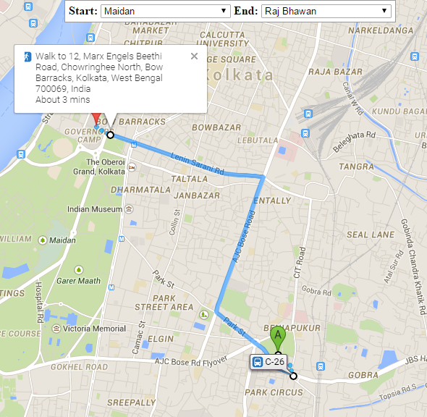
Google Maps API
Latitude and Longitude values
are passed to a inbuilt Google
maps function via the API.
Based on Origin and Destination
being set , the rote for travel is
calculated.

Slide 17
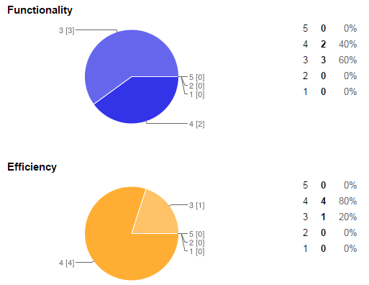
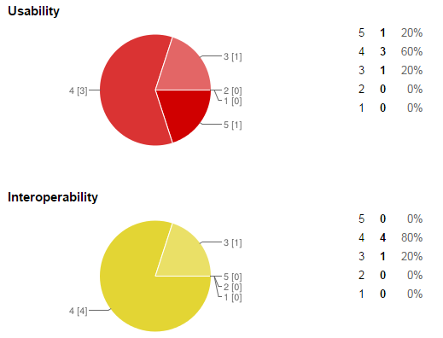
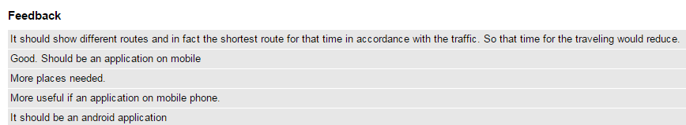
FEEDBACKS AND TESTING DATA

Slide 18
FUTURE SCOPE
Recommender systems.
Applications for Android, iOS ,Windows and other mobile computing platforms.
Inclusion of more APIs for more personalization.
Real time traffic data for better service providing.

Slide 19
REFERNCES :
Wikipedia (http://en.wikipedia.org/wikiApplication_programming_interface)
Google Maps API
(https://maps.googleapis.com/maps/api)
Apache services
(https:source forge.net/projects/xampp/files)

